Slide 1
Graph Data Structure
Dr. Naveen Kumar
Associate Professor
Amity Institute of Information Technology
Amity University Patna

Slide 2
Representations of Graph
two most common ways to represent a graph
Adjacency Matrix
Adjacency List

Slide 3
Adjacency Matrix Representation
An adjacency matrix is a way of representing a graph as a boolean matrix of (0's and 1's).
Let's assume there are n vertices in the graph So, create a 2D matrix adjMat[n][n] having dimension n x n.
If there is an edge from vertex i to j, mark adjMat[i][j] as 1.
If there is no edge from vertex i to j, mark adjMat[i][j] as 0.

Slide 4
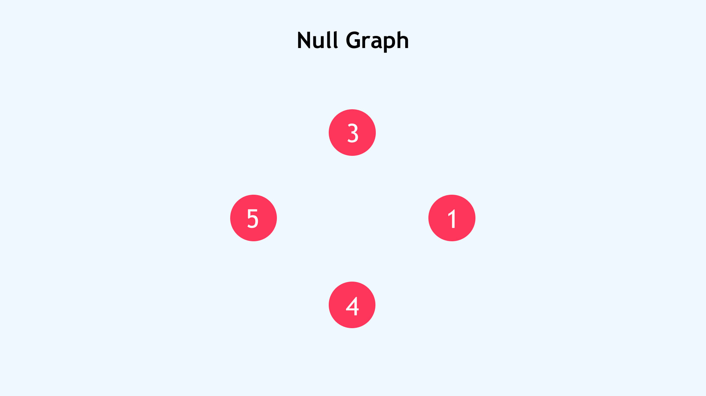

Slide 5
1. Null Graph
A null graph is a graph that consists only of vertices without any edges connecting them.
Use Case: Suppose you're designing a social networking platform and have just fetched a list of newly registered users. At this stage, no one has connected or interacted with anyone else. This is best represented as a null graph. It allows you to account for the users while deferring the connections until they occur naturally in the system.

Slide 6
2. Trivial Graph
A trivial graph contains only a single vertex and no edges.
Use Case: Imagine monitoring a lone weather sensor deployed in a remote area. It doesn’t connect to any other device and functions autonomously. Modeling such a setup as a trivial graph simplifies system design and testing for edge cases.

Slide 7
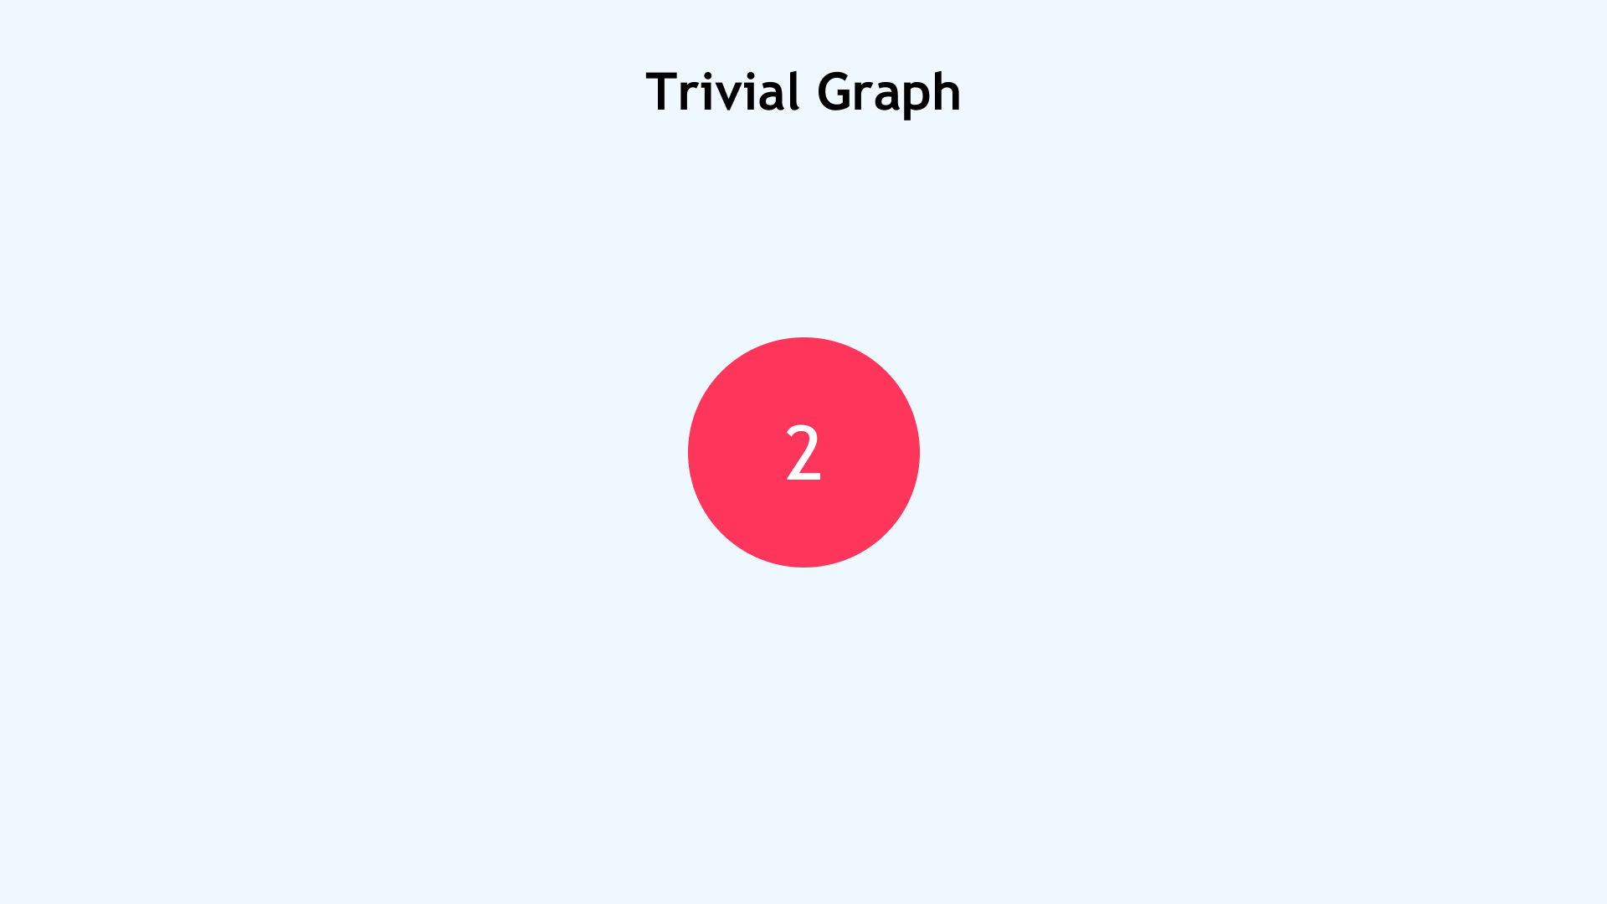

Slide 8
3. Undirected Graph
An undirected graph contains edges with no direction; the connection between any two vertices is mutual. If one vertex connects to another, the relationship is inherently bi-directional.
Use Case Example: You can use undirected graphs to model friend relationships in social media platforms like Facebook. If Aarav is friends with Priya, then Priya is automatically friends with Aarav.

Slide 9
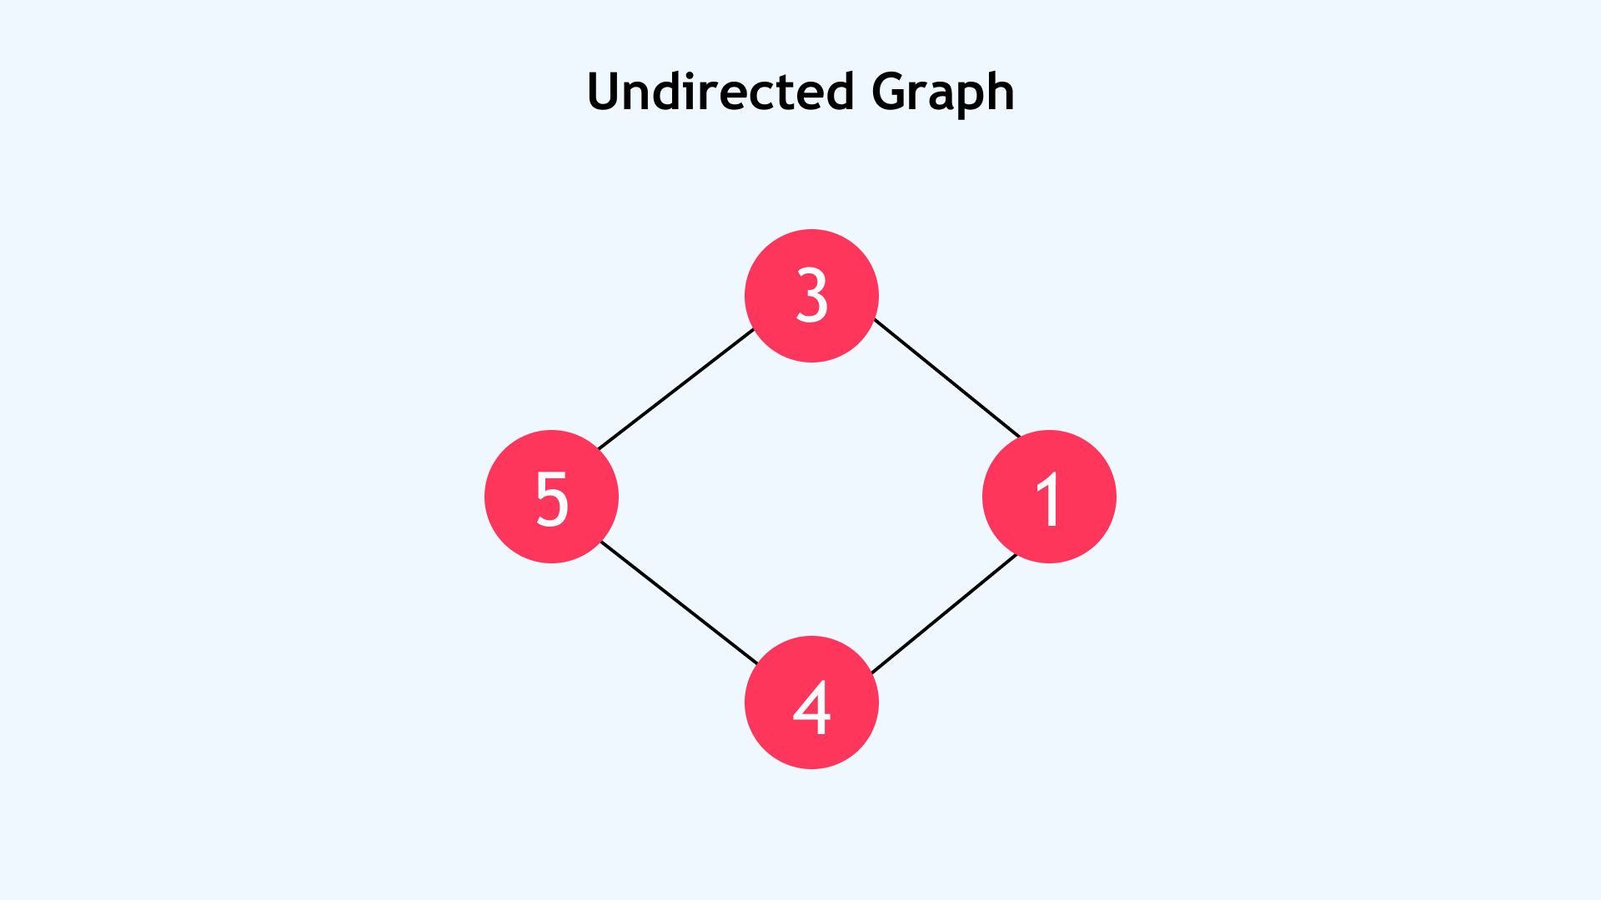

Slide 10
4. Directed Graph (Digraph)
Each edge has a direction, indicating a one-way relationship between two vertices. This makes it suitable for representing scenarios where direction matters, such as flows, hierarchies, or dependencies. Unlike undirected graphs, A -> B does not imply B -> A.
Use Case: Twitter is a classic case where directed graphs are applicable. If you follow someone, it doesn’t mean they follow you back. Directed graphs are also widely used in modeling workflows, task scheduling, and web page linking structures, where navigation flows in a particular direction.

Slide 11
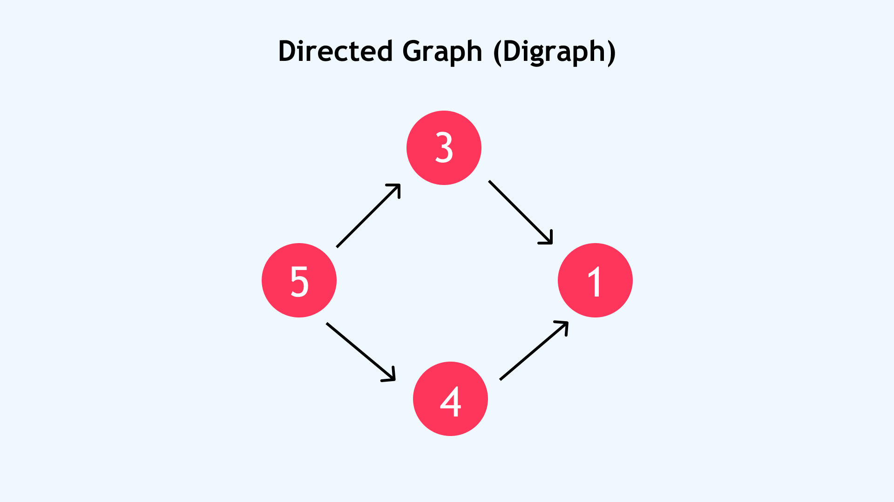

Slide 12
5. Connected Graph

Slide 13
Breadth First Search (Graph Traversal)
BFS is a graph traversal algorithm that starts from a source node and explores the graph level by level.
First, it visits all nodes directly adjacent to the source.
Then, it moves on to visit the adjacent nodes of those nodes, and this process continues until all reachable nodes are visited.

Slide 14
BFS from a Given Source in an Undirected Graph
The algorithm starts from a given source vertex and explores all vertices reachable from that source, visiting nodes in increasing order of their distance from the source, level by level using a queue.
Since graphs may contain cycles, a vertex could be visited multiple times. To prevent revisiting a vertex, a visited array is used.

Slide 15
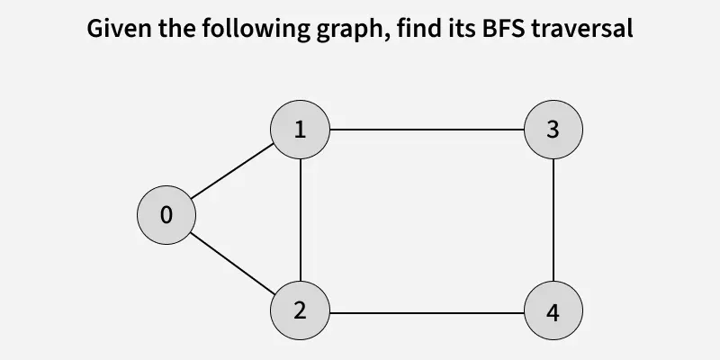

Slide 16
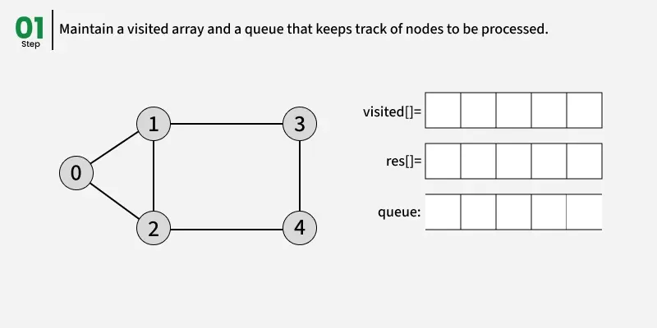

Slide 17
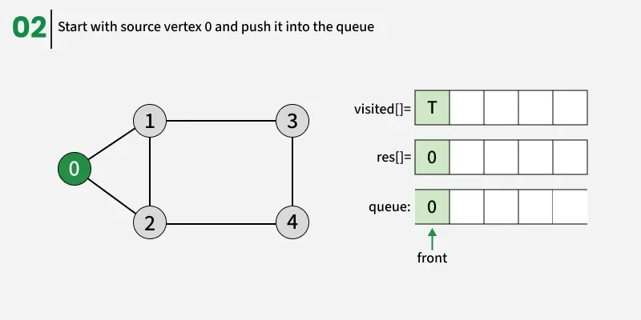

Slide 18
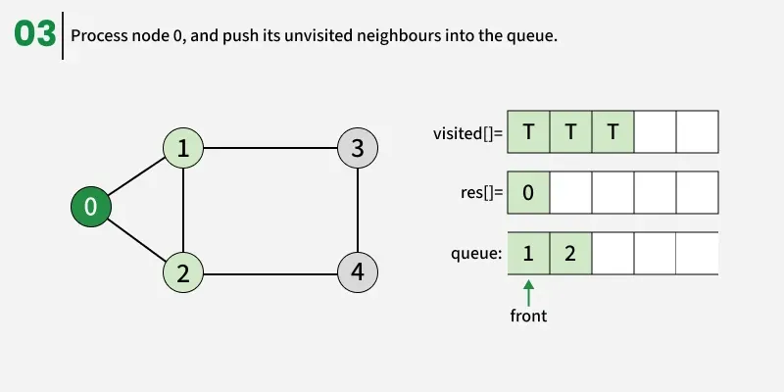

Slide 19
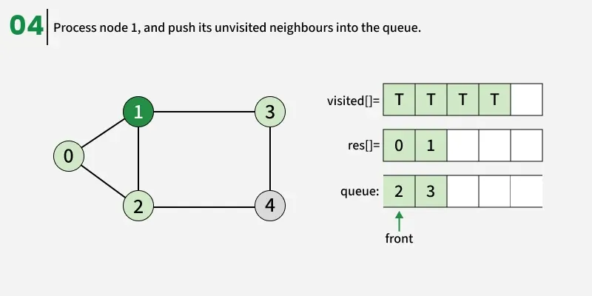

Slide 20
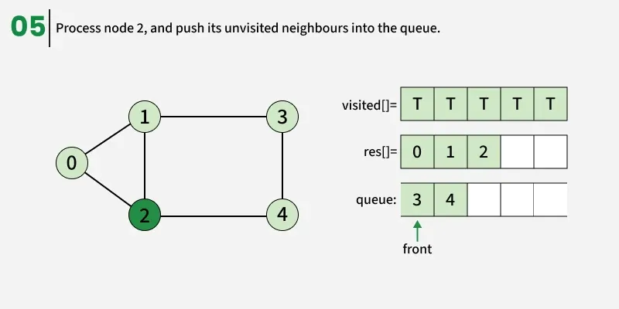

Slide 21
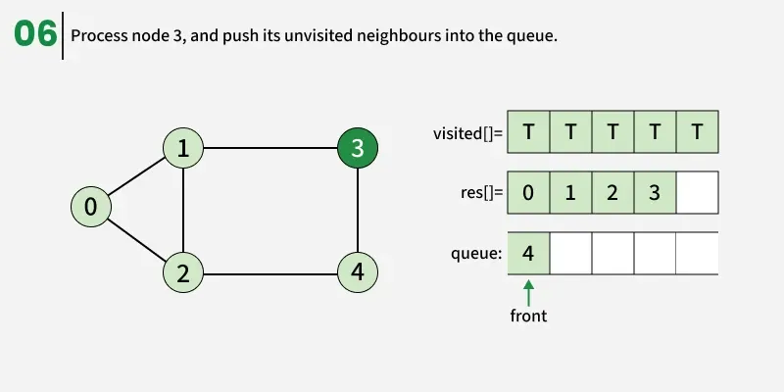

Slide 22
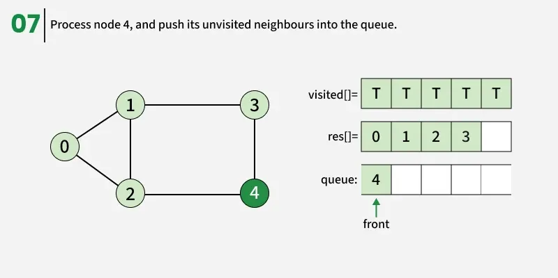

Slide 23
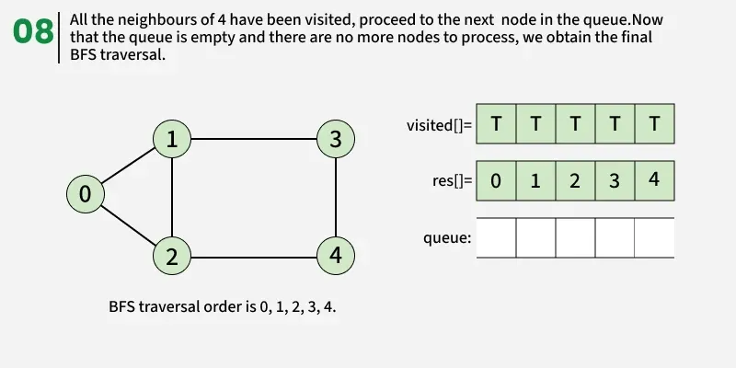

Slide 24
ArrayList<Integer> bfs(ArrayList<ArrayList<Integer>> adj) {
int V = adj.size();
boolean[] visited = new boolean[V];
ArrayList<Integer> res = new ArrayList<>();
int src = 0;
Queue<Integer> q = new LinkedList<>();
visited[src] = true;
q.add(src);
while (!q.isEmpty()) {
int curr = q.poll();
res.add(curr);
// visit all the unvisited
// neighbours of current node
for (int x : adj.get(curr)) {
if (!visited[x]) {
visited[x] = true;
q.add(x);
}
}
}
return res;
}

Slide 25
BFS of a Disconnected Undirected Graph
In a disconnected graph, some vertices may not be reachable from a single source.
To ensure all vertices are visited in BFS traversal, we iterate through each vertex, and if any vertex is unvisited, we perform a BFS starting from that vertex being the source.
This way, BFS explores every connected component of the graph.

Slide 26
void bfsConnected(ArrayList<ArrayList<Integer>> adj, int src, boolean[] visited, ArrayList<Integer> res) {
Queue<Integer> q = new LinkedList<>();
visited[src] = true;
q.add(src);
while (!q.isEmpty()) {
int curr = q.poll();
res.add(curr);
// visit all the unvisited
// neighbours of current node
for (int x : adj.get(curr)) {
if (!visited[x]) {
visited[x] = true;
q.add(x);
}
}
}
}
// BFS for all components (handles disconnected graphs)
ArrayList<Integer> bfs(ArrayList<ArrayList<Integer>> adj) {
int V = adj.size();
boolean[] visited = new boolean[V];
ArrayList<Integer> res = new ArrayList<>();
for (int i = 0; i < V; i++) {
if (!visited[i])
bfsConnected(adj, i, visited, res);
}
return res;
}

Slide 27
Applications of BFS in Graphs
1. Shortest Path and Minimum Spanning Tree for unweighted graph: In an unweighted graph, the shortest path is the path with the least number of edges. With Breadth First, we always reach a vertex from a given source using the minimum number of edges. Also, in the case of unweighted graphs, any spanning tree is Minimum Spanning Tree and we can use either Depth or Breadth first traversal for finding a spanning tree.
2. Minimum Spanning Tree for weighted graphs: We can also find Minimum Spanning Tree for weighted graphs using BFT, but the condition is that the weight should be non-negative and the same for each pair of vertices.
3. Peer-to-Peer Networks: In Peer-to-Peer Networks like BitTorrent, Breadth First Search is used to find all neighbor nodes.
4. Crawlers in Search Engines: Crawlers build an index using Breadth First. The idea is to start from the source page and follow all links from the source and keep doing the same. Depth First Traversal can also be used for crawlers, but the advantage of Breadth First Traversal is, the depth or levels of the built tree can be limited.
5. Social Networking Websites: In social networks, we can find people within a given distance 'k' from a person using Breadth First Search till 'k' levels.
6. GPS Navigation systems: Breadth First Search is used to find all neighboring locations.
7. Broadcasting in Network: In networks, a broadcasted packet follows Breadth First Search to reach all nodes.
8. In Garbage Collection: Breadth First Search is used in copying garbage collection using Cheney's algorithm. Breadth First Search is preferred over Depth First Search because of a better locality of reference.
9. Cycle detection in undirected graph: In undirected graphs, either Breadth First Search or Depth First Search can be used to detect a cycle. We can use BFS to detect cycle in a directed graph also.
10. Ford–Fulkerson algorithm In Ford - Fulkerson algorithm, we can either use Breadth First or Depth First Traversal to find the maximum flow. Breadth First Traversal is preferred as it reduces the worst-case time complexity to O(VE²).

Slide 28
Applications of BFS in Graphs
11. To test if a graph is Bipartite: We can either use Breadth First or Depth First Traversal.
12. Path Finding: We can either use Breadth First or Depth First Traversal to find if there is a path between two vertices.
13. Finding all nodes within one connected component: We can either use Breadth First or Depth First Traversal to find all nodes reachable from a given node.
14. AI: In AI, BFS is used in traversing a game tree to find the best move.
15. Network Security: In the field of network security, BFS is used in traversing a network to find all the devices connected to it.
16. Connected Component: We can find all connected components in an undirected graph.
17. Topological sorting: BFS can be used to find a topological ordering of the nodes in a directed acyclic graph (DAG).
18. Image processing: BFS can be used to flood-fill an image with a particular color or to find connected components of pixels.
19. Recommender systems: BFS can be used to find similar items in a large dataset by traversing the items' connections in a similarity graph.
20. Other usages: Many algorithms like Prim's Minimum Spanning Tree and Dijkstra's Single Source Shortest Path use structures similar to Breadth First Search.

Slide 29
Advantages of Breadth First Search
BFS will never get trapped exploring the useful path forever.
If there is a solution, BFS will definitely find it.
If there is more than one solution then BFS can find the minimal one that requires less number of steps.
Low storage requirement - linear with depth.
Easily programmable.

Slide 30
Disadvantages of Breadth First Search
The main drawback of BFS is its memory requirement.
Since each level of the graph must be saved in order to generate the next level and the amount of memory is proportional to the number of nodes stored the space complexity of BFS is O(b^{d} ), where b is the branching factor(the number of children at each node, the outdegree) and d is the depth.
As a result, BFS is severely space-bound in practice so will exhaust the memory available on typical computers in a matter of minutes.

Slide 31
Depth First Search or DFS for a Graph
In Depth First Search (or DFS), traverse all adjacent vertices one by one.
When we traverse an adjacent vertex, we completely finish the traversal of all vertices reachable through that adjacent vertex.
This is similar to Preorder Traversal of Binary Tree, where we first completely traverse the left subtree and then move to the right subtree.
The key difference is that, unlike trees, graphs may contain cycles (a node may be visited more than once).
To avoid processing a node multiple times, we use a boolean visited array.
Note: There can be multiple DFS traversals of a graph according to the order in which we pick adjacent vertices.

Slide 32
DFS from a Given Source of Graph
Depth First Search (DFS) starts from a given source vertex and explores one path as deeply as possible.
When it reaches a vertex with no unvisited neighbors, it backtracks to the previous vertex to explore other unvisited paths.
This continues until all vertices reachable from the source are visited.
In a graph, there might be loops. So we use an extra visited array to make sure that we do not process a vertex again.

Slide 33
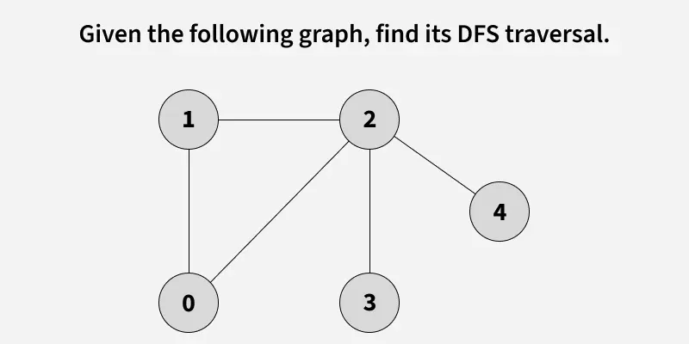

Slide 34
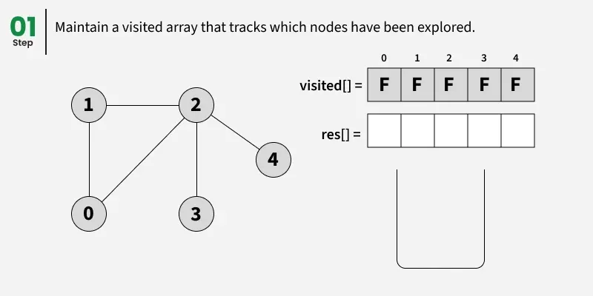

Slide 35
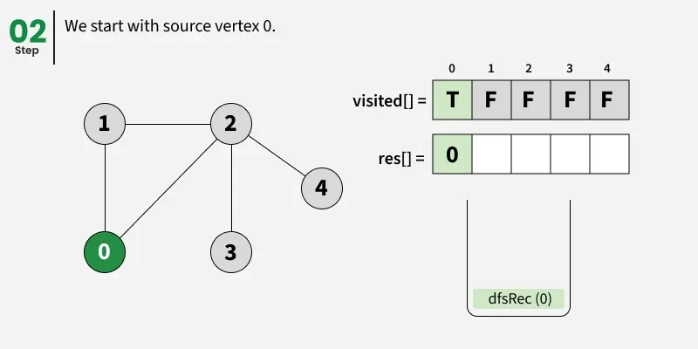

Slide 36
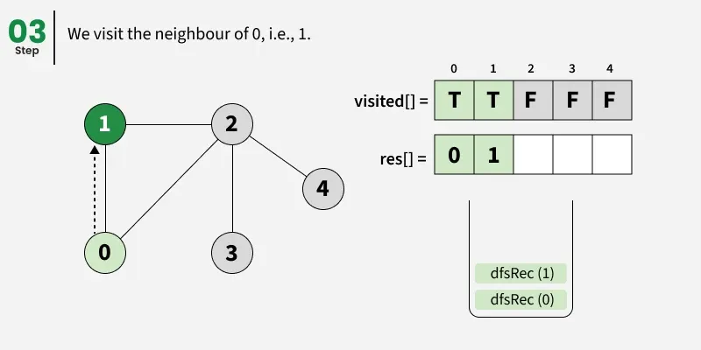

Slide 37
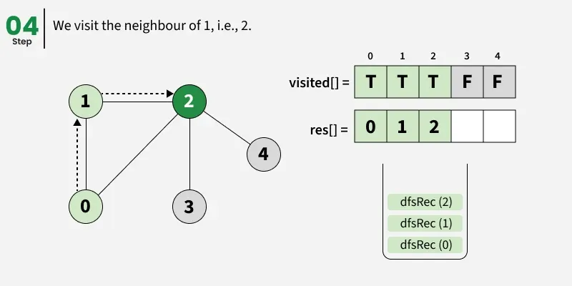

Slide 38
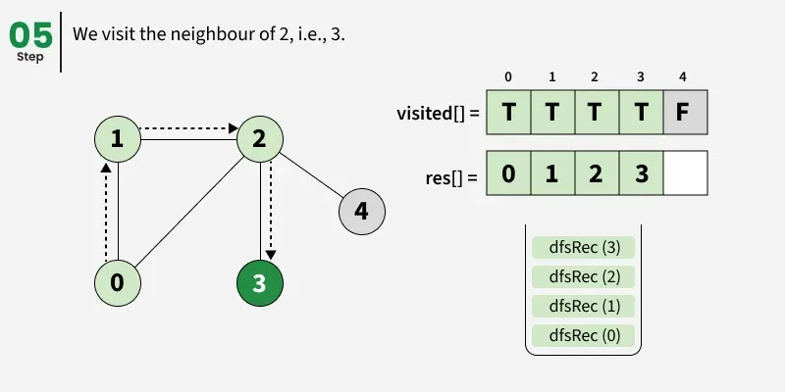

Slide 39
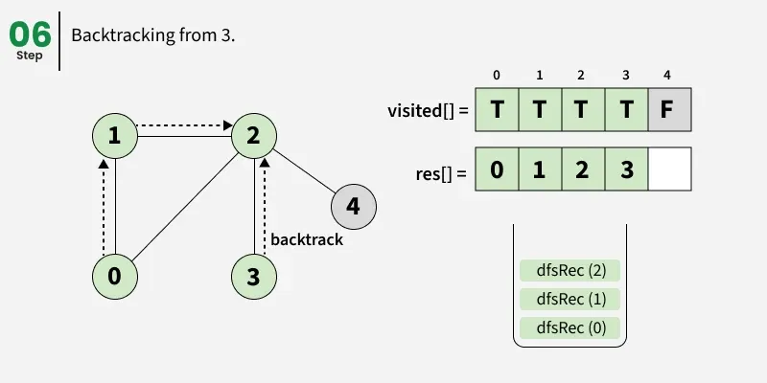

Slide 40
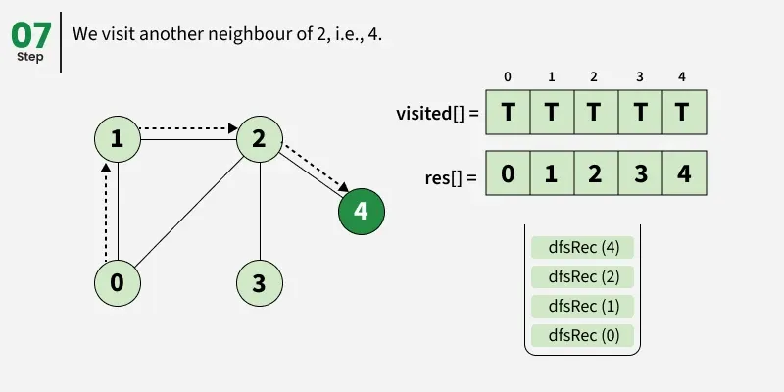

Slide 41
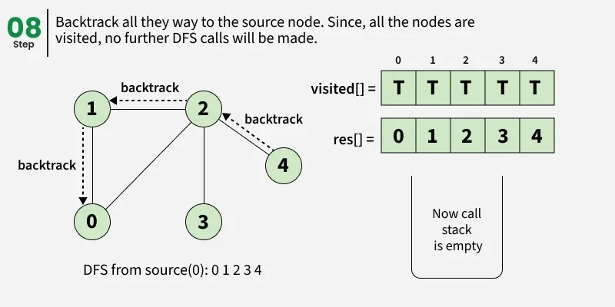

Slide 42
void dfsRec(ArrayList<ArrayList<Integer>> adj,
boolean[] visited, int s, ArrayList<Integer> res)
{
visited[s] = true;
res.add(s);
// Recursively visit all adjacent vertices that are not visited yet
for (int i : adj.get(s)) {
if (!visited[i]) {
dfsRec(adj, visited, i, res);
}
}
}
static ArrayList<Integer>dfs(ArrayList<ArrayList<Integer>> adj) {
boolean[] visited = new boolean[adj.size()];
ArrayList<Integer> res = new ArrayList<>();
dfsRec(adj, visited, 0, res);
return res;
}

Slide 43
Analysis
Time complexity: O(V + E), where V is the number of vertices and E is the number of edges in the graph.
Auxiliary Space: O(V + E), since an extra visited array of size V is required, And stack size for recursive calls to dfsRec function.

Slide 44
DFS of a Disconnected Graph
In a disconnected graph, some vertices may not be reachable from a single source.
To ensure all vertices are visited in DFS traversal,
we iterate through each vertex, and if a vertex is unvisited,
we perform a DFS starting from that vertex being the source.
This way, DFS explores every connected component of the graph.

Slide 45
void dfsRec(ArrayList<ArrayList<Integer> > adj,
boolean[] visited, int s, ArrayList<Integer> res) {
visited[s] = true;
res.add(s);
// Recursively visit all adjacent vertices that are
// not visited yet
for (int i : adj.get(s)) {
if (!visited[i]) {
dfsRec(adj, visited, i, res);
}
}
}
ArrayList<Integer> dfs(ArrayList<ArrayList<Integer> > adj) {
boolean[] visited = new boolean[adj.size()];
ArrayList<Integer> res = new ArrayList<>();
// Loop through all vertices to handle disconnected graphs
for (int i = 0; i < adj.size(); i++) {
if (!visited[i]) {
dfsRec(adj, visited, i, res);
}
}
return res;
}

Slide 46
Analysis
Time complexity: O(V + E). We visit every vertex at most once and every edge is traversed at most once (in directed) and twice in undirected.
Auxiliary Space: O(V + E), since an extra visited array of size V is required, and stack size for recursive calls of dfs function.

Slide 47
Depth First Search or DFS on Directed Graph
In directed graphs, DFS can start from a specific point and explore all the connected nodes.
It can also be used to make sure every part of the graph is visited,
even if the graph has disconnected sections.

Slide 48
Keep a boolean visited array to keep track of which vertices have already been visited. This ensures avoiding infinite loops when there are cycles in the graph.
Use Recursion to visited all unvisited neighbours of source node:
First marks the current vertex as visited and processes the current vertex (for example, by printing its value).
Then, recursively visits each unvisited neighbor of the current vertex.
If a vertex has no unvisited neighbors, backtracks to the previous vertex to explore other unvisited paths.

Slide 49
void DFSRec(List<List<Integer> > adj, boolean[] visited, int s){
// Mark the current vertex as visited
visited[s] = true;
// Print the current vertex
System.out.print(s + " ");
// Recursively visit all adjacent vertices that are not visited yet
for (int i : adj.get(s)) {
if (!visited[i]) {
DFSRec(adj, visited, i);
}
}
}
// Main DFS function that initializes the visited array
void DFS(List<List<Integer> > adj, int s) {
boolean[] visited = new boolean[adj.size()];
// Call the recursive DFS function
DFSRec(adj, visited, s);
}

Slide 50
Analysis
Time complexity: O(V + E), where V is the number of vertices and E is the number of edges in the graph.
Auxiliary Space: O(V + E), since an extra visited array of size V is required, And stack size for recursive calls to DFSRec function.

Slide 51
DFS for Complete Traversal of Disconnected Directed Graphs
In a directed graph, edges have a specific direction means we can travel from one vertex to another only in the direction the edge points.
A disconnected graph is one in which not all vertices are reachable from a single vertex.
The above implementation takes a source as an input and prints only those vertices that are reachable from the source and would not print all vertices in case of disconnected graph. Let us now talk about the algorithm that prints all vertices without any source and the graph maybe disconnected.
To handle such a graph in DFS, we must ensure that the DFS algorithm starts from every unvisited vertex and this results in covering all components of the graph

Slide 52
// Recursive function for DFS traversal
void DFSRec(List<List<Integer> > adj, boolean[] visited, int s){
visited[s] = true;
System.out.print(s + " ");
// Recursively visit all adjacent vertices that are
// not visited yet
for (int i : adj.get(s)) {
if (!visited[i]) {
DFSRec(adj, visited, i);
}
}
}
// Main DFS function to perform DFS for the entire graph
void DFS(List<List<Integer> > adj, int V){
boolean[] visited = new boolean[V];
// Loop through all vertices to handle disconnected graph
for (int i = 0; i < V; i++) {
if (!visited[i]) {
DFSRec(adj, visited, i);
}
}
}

Slide 53
Complexity Analysis
Time Complexity: O(V + E). Note that the time complexity is same here because we visit every vertex at most once and every edge is traversed at most once (in directed) and twice in undirected.
Auxiliary Space: O(V + E), since an extra visited array of size V is required, And stack size for recursive calls to DFSRec function.

Slide 54
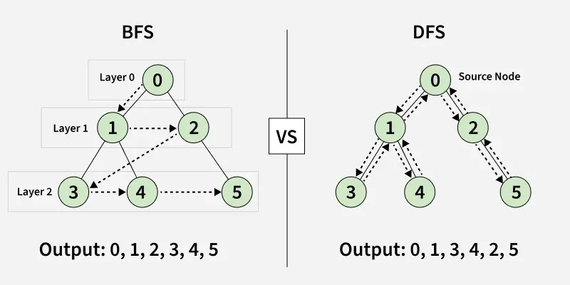
BFS vs DFS

Slide 55
Parameters | BFS | DFS
Stands for | BFS stands for Breadth First Search. | DFS stands for Depth First Search.
Data Structure | BFS(Breadth First Search) uses Queue data structure for finding the shortest path. | DFS(Depth First Search) uses Stack data structure.
Definition | BFS is a traversal approach in which we first walk through all nodes on the same level before moving on to the next level. | DFS is also a traversal approach in which the traverse begins at the root node and proceeds through the nodes as far as possible until we reach the node with no unvisited nearby nodes.
Conceptual Difference | BFS builds the tree level by level. | DFS builds the tree sub-tree by sub-tree.
Approach used | It works on the concept of FIFO (First In First Out). | It works on the concept of LIFO (Last In First Out).
Suitable for | BFS is more suitable for searching vertices closer to the given source. | DFS is more suitable when there are solutions away from source.
Applications | BFS is used in various applications such as bipartite graphs, shortest paths, etc. If weight of every edge is same, then BFS gives shortest path from source to every other vertex. | DFS is used in various applications such as acyclic graphs and finding strongly connected components etc. There are many applications where both BFS and DFS can be used like Topological Sorting, Cycle Detection, etc.

Slide 56
Rotten Oranges - Minimum Time to Rot All
Given a matrix mat[][], where each cell in the matrix can have values 0, 1 or 2 which has the following meaning:
0: Empty cell
1: Cells have fresh oranges
2: Cells have rotten oranges
Find the minimum time required so that all the oranges become rotten. A rotten orange at index (i,j) can rot other fresh oranges which are its neighbours (up, down, left, and right). Each rotten orange takes 1 unit of time to rot all its adjacent fresh oranges.
Note : If it is impossible to rot every orange then simply return -1.
Examples:
Input: mat[][] = [[2, 1, 0, 2, 1], [1, 0, 1, 2, 1], [1, 0, 0, 2, 1]]
Output: 2

Slide 57
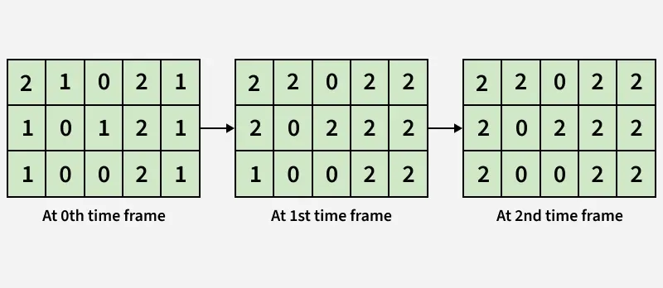

Slide 58
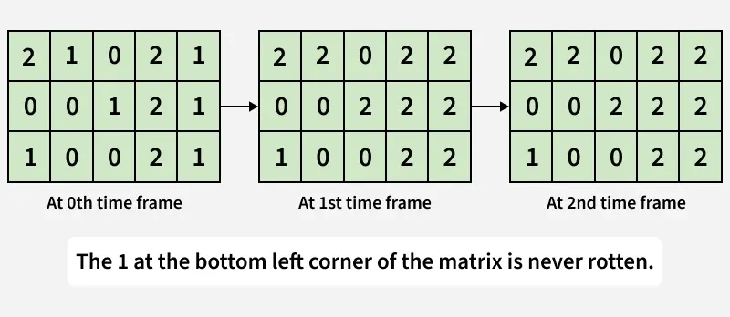

Slide 59
Using Iteration - O((n x m) ^ 2) Time and O(1) Space

Slide 60
boolean isSafe(int i, int j, int n, int m) {
return 0 <= i && i < n && 0 <= j && j < m;
}
public int orangesRot(int[][] mat) {
int n = mat.length;
int m = mat[0].length;
boolean changed; // to check if any changes are made
int elapsedTime = 0; // counter of elapsed time
// all four directions
int[][] directions = {{1, 0}, {0, 1}, {-1, 0}, {0, -1}};
// iterate until changes are there
while (true) {
changed = false;
for (int i = 0; i < n; i++) {
for (int j = 0; j < m; j++) {
// check if the cell was marked in last iteration
if (mat[i][j] == elapsedTime + 2) {
// change 4-directionally connected cells
for (int[] dir : directions) {
int x = i + dir[0];
int y = j + dir[1];
// if cell is in the matrix and the
//orange is fresh
if (isSafe(x, y, n, m) && mat[x][y] == 1) {
mat[x][y] = mat[i][j] + 1;
changed = true;
}
}
}
}
}

Slide 61
// if no changes are done
if (!changed) {
break;
}
elapsedTime++;
}
for (int i = 0; i < n; i++) {
for (int j = 0; j < m; j++) {
// if any orange is found not rotten, return -1
if (mat[i][j] == 1) {
return -1;
}
}
}
return elapsedTime;
}

Slide 62
Using Depth First Search - O(n x m) Time and O(1) Space
Start by iterating through the entire matrix, and whenever we find a rotten orange (2), begin a DFS from that cell.
During the DFS, go to all its adjacent cells and record the time when each orange becomes rotten. If a neighboring cell contains a fresh orange (1), that means it can now become rotten, so we recursively call DFS for that cell with the time current_time + 1.
If a cell was already rotten earlier but now can rot in less time, update its time and continue DFS from that cell again.
In this way, DFS helps spread the rot recursively throughout the grid while keeping track of the minimum time taken for each orange to rot.
After all DFS calls are complete, iterate through the entire matrix once again.
If any fresh orange still left, it means it was unreachable, so we return -1.
Otherwise, take the maximum recorded time — which represents the minimum time required to rot all the oranges.

Slide 63
boolean isSafe(int i, int j, int n, int m) {
return (i >= 0 && i < n && j >= 0 && j < m);
}
// function to perform dfs and find fresh orange
void dfs(int[][] mat, int i, int j, int time) {
int n = mat.length;
int m = mat[0].length;
// update minimum time
mat[i][j] = time;
// all four directions
int[][] directions
= {{1, 0},{0, 1}, {-1, 0},{0, -1}};
// change 4-directionally connected cells
for (int[] dir : directions) {
int x = i + dir[0];
int y = j + dir[1];
// if cell is in the matrix and
// the orange is fresh
if (isSafe(x, y, n, m)
&& (mat[x][y] == 1
|| mat[x][y] > time + 1)) {
dfs(mat, x, y, time + 1);
}
}
}

Slide 64
int orangesRot(int[][] mat) {
int n = mat.length;
int m = mat[0].length;
int elapsedTime = 0; // counter of elapsed time
// iterate through all the cells
for (int i = 0; i < n; i++) {
for (int j = 0; j < m; j++) {
// if orange is initially rotten
if (mat[i][j] == 2) {
dfs(mat, i, j, 2);
}
}
}
// iterate through all the cells
for (int i = 0; i < n; i++) {
for (int j = 0; j < m; j++) {
// if orange is fresh
if (mat[i][j] == 1)
return -1;
// update the maximum time
elapsedTime
= Math.max(elapsedTime, mat[i][j] - 2);
}
}
return elapsedTime;
}

Slide 65
Using Breadth First Search - O(n x m) Time and O(n x m) Space
first add all the initially rotten oranges to a queue.
Then, process them one by one from the queue.
For each rotten orange, check its four neighboring cells.
If a neighbor is a fresh orange (1), it becomes rotten, and enqueue it into the queue, as BFS moves level by level,
Also keep track of a variable to record the time taken — this value increases with each level processed.
Once the queue becomes empty, it means all possible oranges have been processed.
Finally, check the grid again — if any fresh orange is still left, it means it couldn’t be reached, so return -1.
Otherwise, the maximum time recorded gives the minimum time required to rot all the oranges.

Slide 66
boolean isSafe(int i, int j, int n, int m) {
return (i >= 0 && i < n && j >= 0 && j < m);
}
// function to perform bfs and find minimum time
static int orangesRot(int[][] mat) {
int n = mat.length;
int m = mat[0].length;
// queue to store coordinates of rotten oranges
Queue<int[]> q = new LinkedList<>();
// counter of elapsed time
int elapsedTime = 0;
// push all initially rotten oranges into queue
for (int i = 0; i < n; i++) {
for (int j = 0; j < m; j++) {
if (mat[i][j] == 2) {
q.add(new int[]{i, j});
}
}
}
// directions for all four adjacent cells
int[][] directions = {{1, 0}, {0, 1}, {-1, 0}, {0, -1}};
// perform BFS
while (!q.isEmpty()) {
int size = q.size();
boolean flag = false;

Slide 67
// process all oranges at current time level
for (int i = 0; i < size; i++) {
int[] cell = q.poll();
int x = cell[0];
int y = cell[1];
// check all four directions
for (int[] dir : directions) {
int nx = x + dir[0];
int ny = y + dir[1];
// if cell is safe and has fresh orange
if (isSafe(nx, ny, n, m) && mat[nx][ny] == 1) {
// rot the orange
mat[nx][ny] = 2;
q.add(new int[]{nx, ny});
flag = true;
}
}
}
// if at least one orange got rotten, increase the time
if (flag)
elapsedTime++;
}
// check if any fresh orange still remains
for (int i = 0; i < n; i++) {
for (int j = 0; j < m; j++) {
if (mat[i][j] == 1)
return -1;
}
}
return elapsedTime;
}
}
}
}
// if at least one orange got rotten, increase the time
if (flag)
elapsedTime++;
}
// check if any fresh orange still remains
for (int i = 0; i < n; i++) {
for (int j = 0; j < m; j++) {
if (mat[i][j] == 1)
return -1;
}
}
return elapsedTime;
}

Slide 68
class Graph {
private int V; // Number of vertices
private LinkedList<Integer>[] adj; // Adjacency List
Graph(int v) {
V = v;
adj = new LinkedList[v];
for (int i = 0; i < v; ++i)
adj[i] = new LinkedList();
}
void addEdge(int v, int w) {
adj[v].add(w); // Add w to v's list
}
// Helper function for recursion
private void DFSUtil(int v, boolean[] visited) {
visited[v] = true; // Mark current node as visited
System.out.print(v + " ");
// Recur for all the vertices adjacent to this vertex
for (int neighbor : adj[v]) {
if (!visited[neighbor]) {
DFSUtil(neighbor, visited); }
}
}
void recursiveDFS(int v) {
boolean[] visited = new boolean[V];
DFSUtil(v, visited);
}
}

Slide 69
void iterativeDFS(int startNode) {
boolean[] visited = new boolean[V];
Stack<Integer> stack = new Stack<>();
// Push the current source node
stack.push(startNode);
while (!stack.isEmpty()) {
int v = stack.pop();
// Stack may contain same vertex multiple times.
// Only process if it hasn't been visited.
if (!visited[v]) {
System.out.print(v + " ");
visited[v] = true;
}
// Get all adjacent vertices of the popped vertex.
// Push unvisited neighbors onto stack.
for (int neighbor : adj[v]) {
if (!visited[neighbor]) {
stack.push(neighbor);
}
}
}
}

Slide 70
Priority Queue
A priority queue is a special type of queue where elements are served based on their priority value rather than just their insertion order, with higher-priority elements removed first.
It operates as an abstract data type commonly implemented using binary heaps, ensuring efficient insertion O(logn) and extraction of the highest-priority element O(logn) or O(1).
Order of Service: Elements with higher priority are dequeued before lower-priority ones, regardless of when they arrived.

Slide 71
Types
Max-Heap: The element with the highest value has the highest priority.
Min-Heap: The element with the lowest value has the highest priority.

